Slide 1
Exploration of Population Dynamics of Swedish Wolves
Nirbhay Bondili & Emily Nikiforuk

Slide 2
The Problem
Model the wolf population in Sweden
Calculate birth & death rates
Explore possibilities of extinction
Calculate mean and variance in population size as function of time

Slide 3
Introduction
Prior to 1991:
Small and stable population, possible inbreeding depression due to lack of new genes entering the population
After 1991:
Russian wolf was introduced to the population in hopes of bringing new genes and increasing the population’s allelic diversity and population size
Demographic stochasticity = treating births and deaths as a discrete, probabilistic event
Has a strong effect in smaller populations

Slide 4
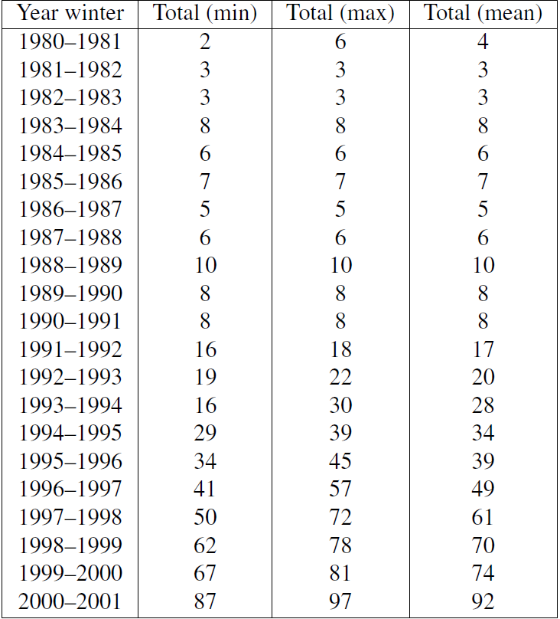
Data

Slide 5
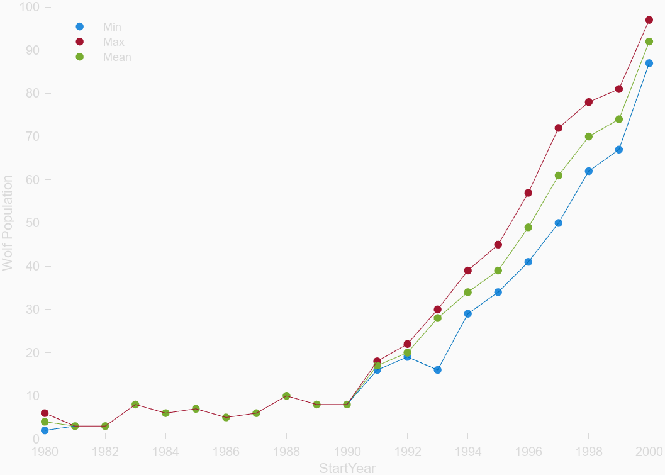

Slide 6
Assumptions
One reproductive couple per pack [1]
One litter per year per pack [1]
Average litter = 5 pups [2]
Reproduction attempts are constant
50-50 distribution of gender
Average pack = 10 Wolves [2]
Average age = 12 [2]

Slide 7
Discrete Time Model
Prior to 1990:
P_{n+1} = P_{n} + 5(1-d) P_{n+1} = P_{n} + 5r
d = 0.9 r = 0.1
Parameters:
P_{n} = population size
r = growth factor
After 1990:
P_{n+1} = P_{n}(1 + r)
r = 0.18

Slide 8
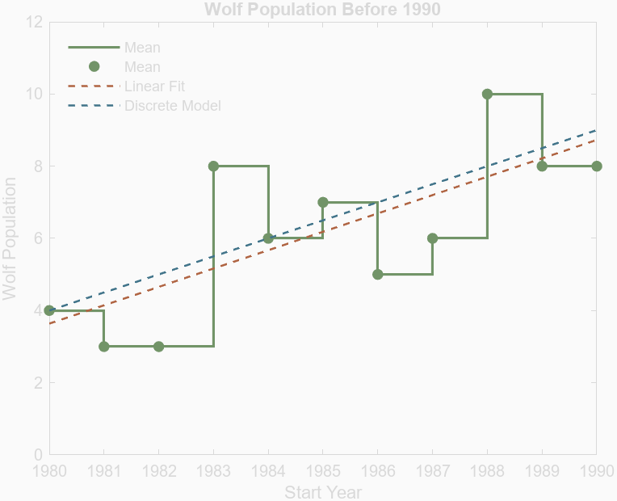
P_{n+1} = P_{n} + 5r
d = 0.9
r = 0.1

Slide 9
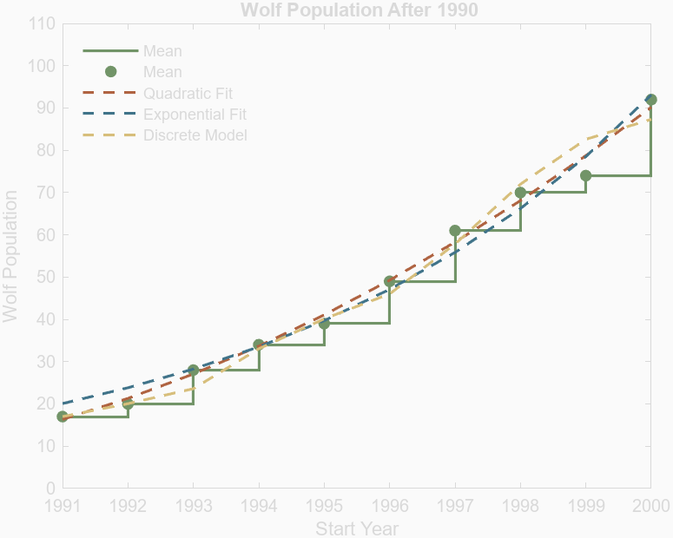
P_{n+1} = P_{n}(1 + r)
r = 0.18

Slide 10
Stochastic Model
Parameters:
b = birth rate
d= death rate
n(t) = population size at time t
Each birth is a Poisson process:
The probability of a birth occurring in the time interval [t, t+τ] is proportional to τ
o(τ) = probability of more than 1 event occurring during the time period τ
For n individuals:
Pr(1 birth in [t, t+τ]) =nbτ + o(τ)
Pr(1 death in [t, t+τ]) = ndτ + o(τ)
Pr(no change in [t, t+τ]) = 1 - n(b+d)τ + o(τ)

Slide 11
Stochastic Model
Rearrange into a differential equation:
p_{n}(t + τ ) = (n − 1) bτ p_{n−1}(t)
+(n + 1) dτ p_{n}+1(t) + (1 − nτ (b + d)) p_{n}(t) + o(τ ),
Take solution as τ → 0
dp_{n}/dt = (n − 1) b p_{n}−1 + (n + 1) d p_{n+1} −
(b + d) n p_{n},
Solution of equation (moment 1 and 2):
M₁(t) = n₀e^{bt}
M₂(t) = 2bM₂ + bM₁
Variance:
var(N(t)) =(n0 (b + d)/r) * e^{rt} * (e^{rt} − 1).

Slide 12
Integration of Stochasticity into model
Cannot explicitly model with insufficient data
Use Matlab to compute simulations
Simulate many times to get a good grasp of behaviour

Slide 13
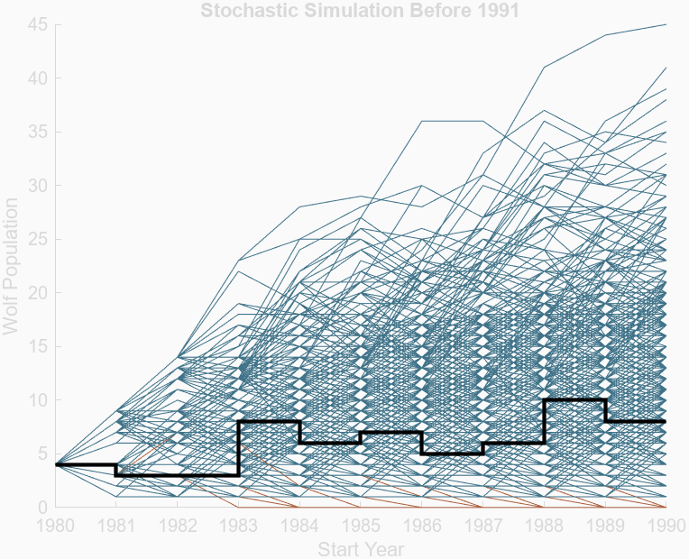
Parameters
r = 0.1
b1 = 0.2
d1 = 0.1
999 Simulations

Slide 14
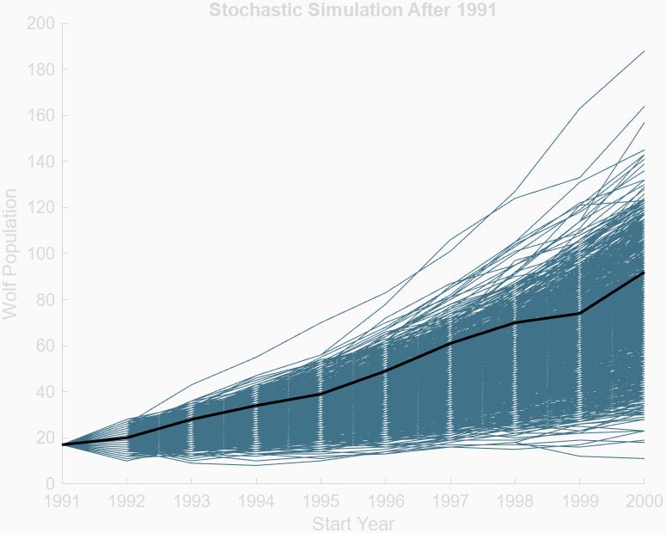
Parameters
r = 0.18
b2 = 0.5
d1 = 0.32
999 Simulations

Slide 15
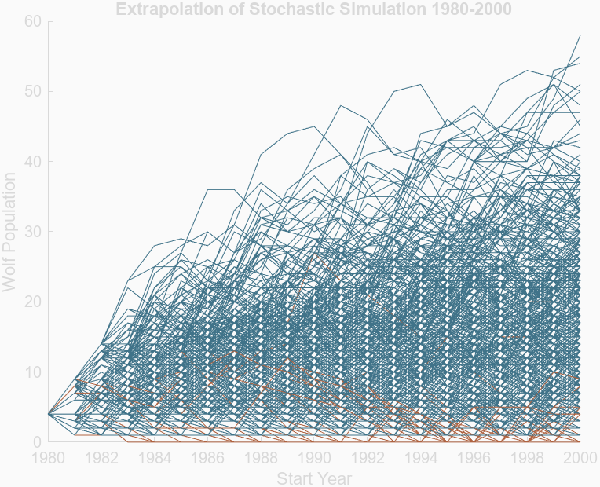
Parameters
r = 0.1
b1 = 0.2
d1 = 0.1
999 Simulations
Mean Extinction time
13.98 years
125 extinction simulations
12.5% probability of extinction at time 20 years

Slide 16
Results
Birth And Death Rates
Before 1991 (b1-d1) = 0.1
After 1991 (b2-d2) = 0.18
Mean time to extinction
14 years
Mean and variance of population as functions of time
Plots on next slide

Slide 17
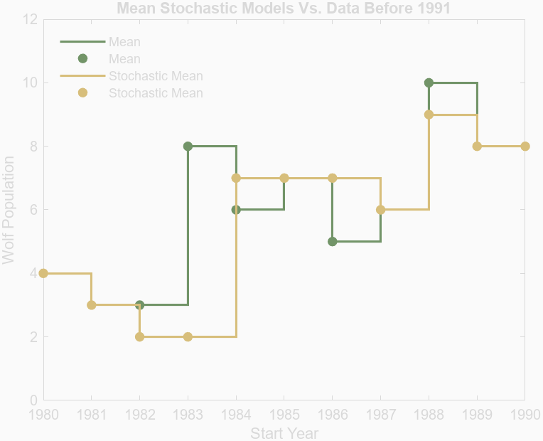
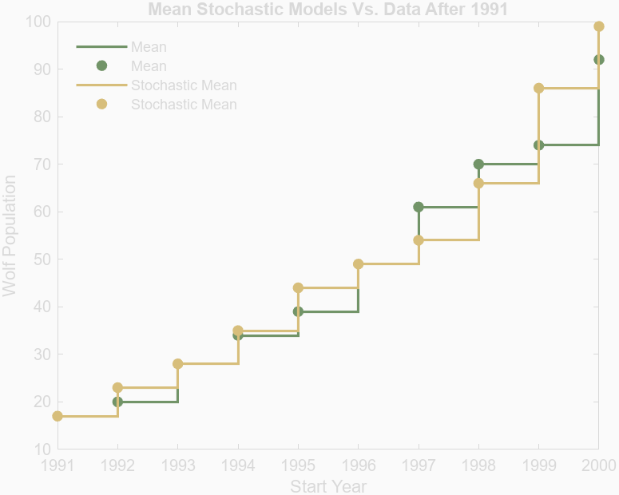
Comparison of Simulations and Data Means

Slide 18
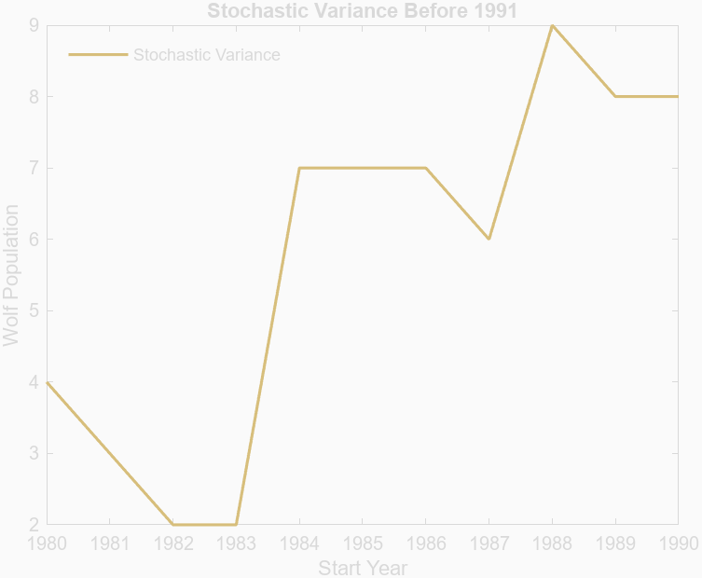
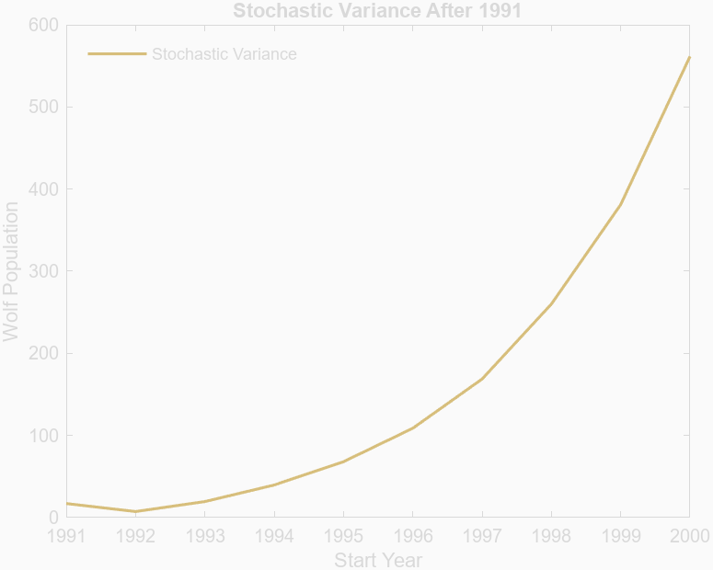
Variance of Simulations

Slide 19
Interpretation of Results
Before 1991:
Population was stagnant, not a lot of growth
Extinction possible
After 1991:
The introduction of a new wolf sparked population growth
Extinction avoided for time being

Slide 20
Limitations & Critique of the Models
Discrete
Stochastic
Data has insufficient parameters
Cannot include stochasticity
Many assumptions made
No explicit model
Could assume exponential after 1991 for mean and variance
General
Did not look for MVP in large time periods
Unable to test DNA
Forced all wolves into packs

Slide 21
Thank you!

Slide 22
References
1. O. Liberg. Genetic aspects of viability in small populations with special
emphasis on the Scandinavian wolf population, Sweden, 2005, International
Expert Workshop at Farna Herrgard.
2. https://www.adfg.alaska.gov/static/education/wns/wolf.pdf

